Slide 1
General parameter-shift rule
Vu Tuan Hai
28/5/2022

Slide 2

1. Basic definition
Variational quantum algorithm (VQA) is a quantum-classical hybrid scheme
Update $θ$
Quantum part
Classical part
Input
Cost value

Slide 3
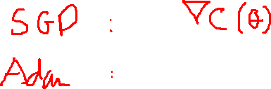
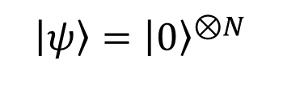
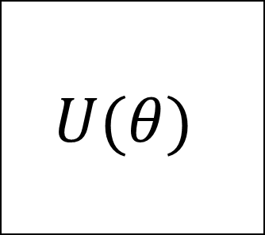
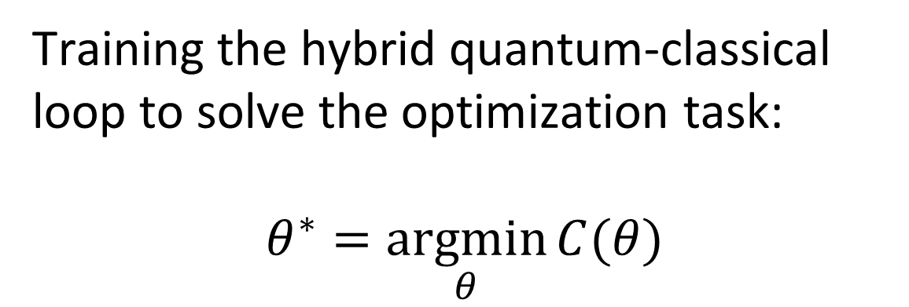
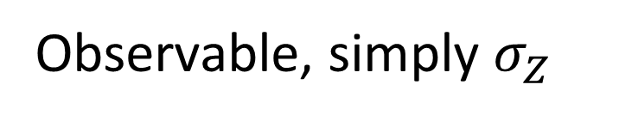

1. Basic definition
$$U(θ)$$
$$C\left(θ\right)≔⟨ψ\left|U^{†}\hat{B}U\right|ψ⟩$$
$\left|ψ\right\rangle ={\left|0\right\rangle }^{⊗N}$
Measure
Training the hybrid quantum-classical loop to solve the optimization task:
$$θ^{∗}=\underset{θ}{argmin}{C(θ)}$$
Observable, simply $σ_{Z}$

Slide 4

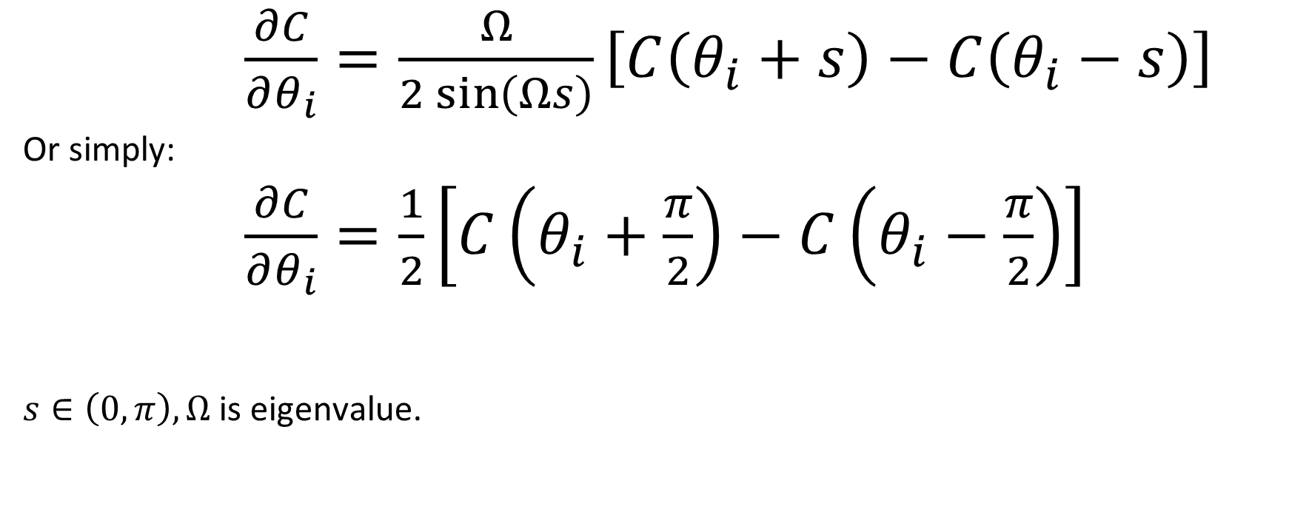


2. Parameter-shift rule
$\frac{∂C}{∂θ_{i}}=\frac{Ω}{2\sin\left(Ωs\right)}\left[C\left(θ_{i}+s\right)−C\left(θ_{i}−s\right)\right]$
Or simply:
$\frac{∂C}{∂θ_{i}}=\frac{1}{2}\left[C\left(θ_{i}+\frac{π}{2}\right)−C\left(θ_{i}−\frac{π}{2}\right)\right]$
$s∈\left(0,π\right),Ω$ is eigenvalue.
$$R_{Y}(θ)$$
$$λ=\{−1,1\}$$
Mitarai et al. (2018), and extended in Schuld et al. (2018)

Slide 5


Examples
$f\left(x\right)=\sin{x}$
$f^{′}\left(x\right)=\frac{1}{2}\left[\sin\left(x+\frac{π}{2}\right)−sin⁡(x−\frac{π}{2})\right]=\frac{1}{2}\left[\cos\left(x\right)+cos⁡(x)\right]$
$=cos⁡(x)$

Slide 6
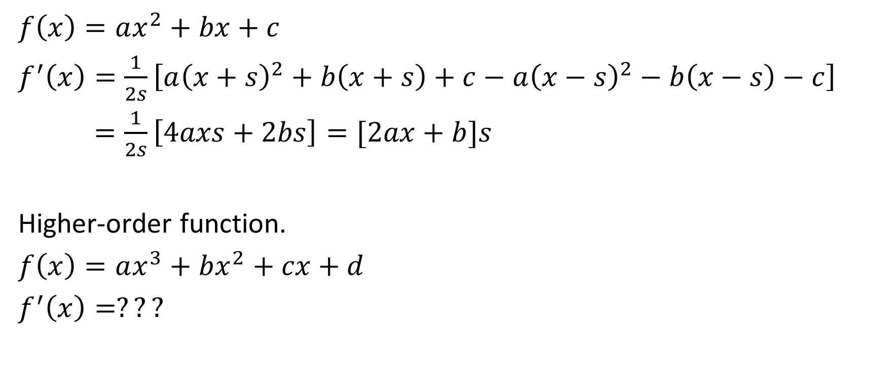

Examples
$f\left(x\right)=ax^{2}+bx+c$
$f^{′}\left(x\right)=\frac{1}{2s}\left[a{\left(x+s\right)}^{2}+b\left(x+s\right)+c−a{\left(x−s\right)}^{2}−b\left(x−s\right)−c\right]$
$=\frac{1}{2s}\left[4axs+2bs\right]=[2ax+b]s$
Higher-order function.
$f\left(x\right)=ax^{3}+bx^{2}+cx+d$
$f^{′}\left(x\right)=???$

Slide 7
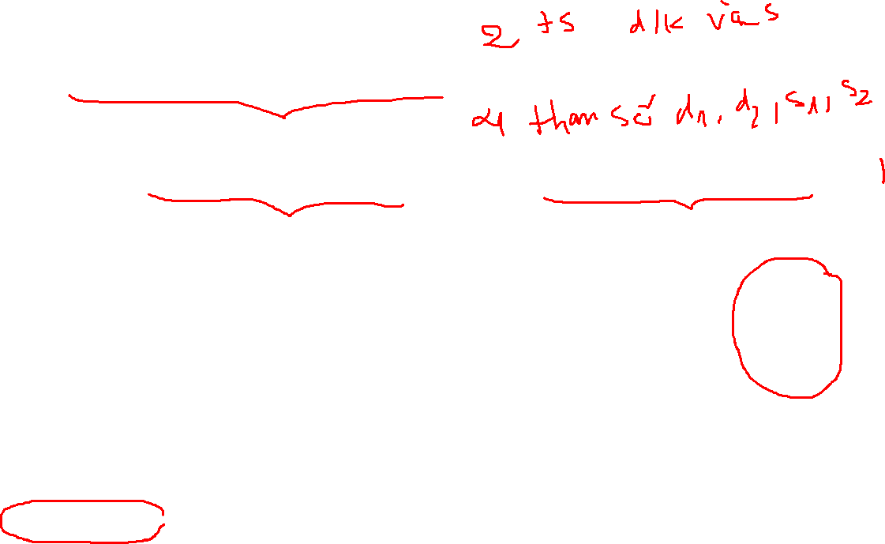



2. Four – term parameter-shift rule
$\frac{∂C}{∂θ_{i}}=d_{1}\left[C\left(θ_{i}+s_{1}\right)−C\left(θ_{i}−s_{1}\right)\right]−d_{2}\left[C\left(θ_{i}+s_{2}\right)−C\left(θ_{i}−s_{2}\right)\right]$
$$R_{Y}(θ)$$
$$λ=\{−1,0,1\}$$
Kottmann (2021)

Slide 8
2. General parameter-shift rule
General parameter-shift rules for quantum gradients, Quantum, volume 6, page 677

Slide 9
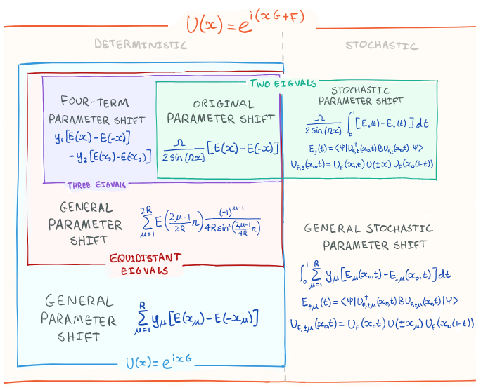

Slide 10
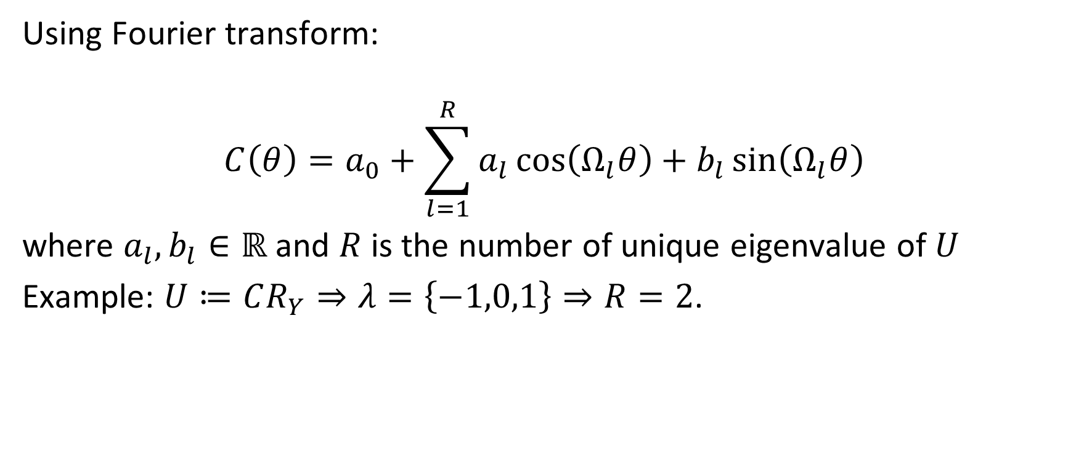
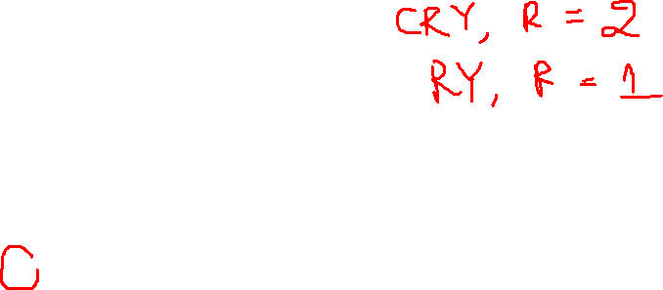
2. General parameter-shift rule
Using Fourier transform:
$$C\left(θ\right)=a_{0}+\sum_{l=1}^{R}{a_{l}\cos\left(Ω_{l}θ\right)+b_{l}\sin\left(Ω_{l}θ\right)}$$
where $a_{l},b_{l}∈ℝ$ and $R$ is the number of unique eigenvalue of $U$
Example: $U≔CR_{Y}⇒λ=\left\{−1,0,1\right\}⇒R=2$.

Slide 11
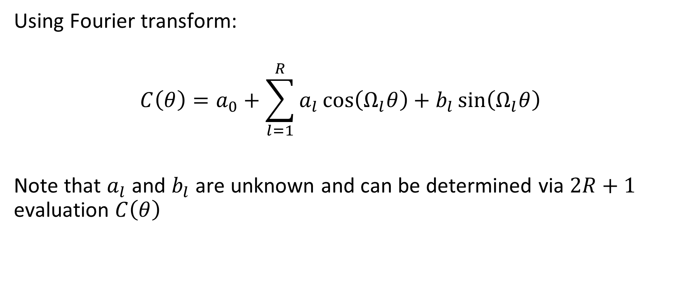
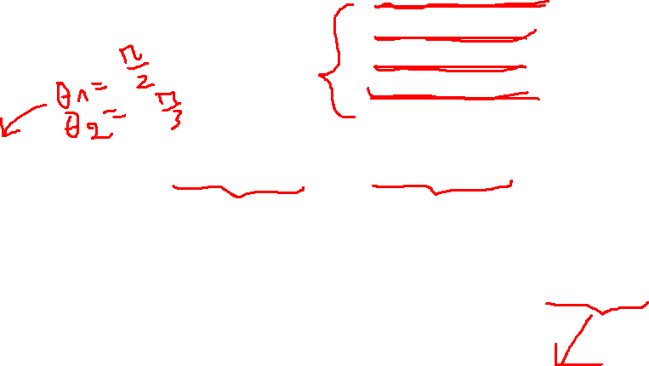
2. General parameter-shift rule
Using Fourier transform:
$$C\left(θ\right)=a_{0}+\sum_{l=1}^{R}{a_{l}\cos\left(Ω_{l}θ\right)+b_{l}\sin\left(Ω_{l}θ\right)}$$
Note that $a_{l}$ and $b_{l}$ are unknown and can be determined via $2R+1$ evaluation $C\left(θ\right)$

Slide 12


2. General parameter-shift rule
$∂C\left(θ\right)=Ω_{l}\sum_{l=1}^{R}{{−a}_{l}\sin\left(Ω_{l}θ\right)+b_{l}\cos\left(Ω_{l}θ\right)}$
Or:
$∂C\left(0\right)=\sum_{μ=1}^{R}{d_{μ}\left(C\left(θ+s_{μ}\right)−C(θ−s_{μ})\right)}$

Slide 13

3. Lagrange interpolation (developing)
$$P\left(x\right)=\sum_{i=1}^{n+1}{P\left(x_{i}\right).\prod_{j=1,j≠i}^{n+1}{(\frac{x−x_{j}}{x_{i}−x_{j}})}}$$
$$e^{−ixG}=\sum_{k=0}^{n−1}{e^{−ixλ_{k}}.\prod_{l=0,l≠k}^{n−1}{(\frac{G−λ_{l}I}{λ_{k}−λ_{l}})}}$$

Slide 14
-> Ap dụng các phương pháp bên deep learning theory principle
-> Sử dụng HMM để giải hệ phương trình tuyến tính => fully quantum

Slide 15
3. Lagrange interpolation (developing)
This approach uses less number of evaluation than general parameter-shift rule in case n = 4 and n = 5.

Slide 16
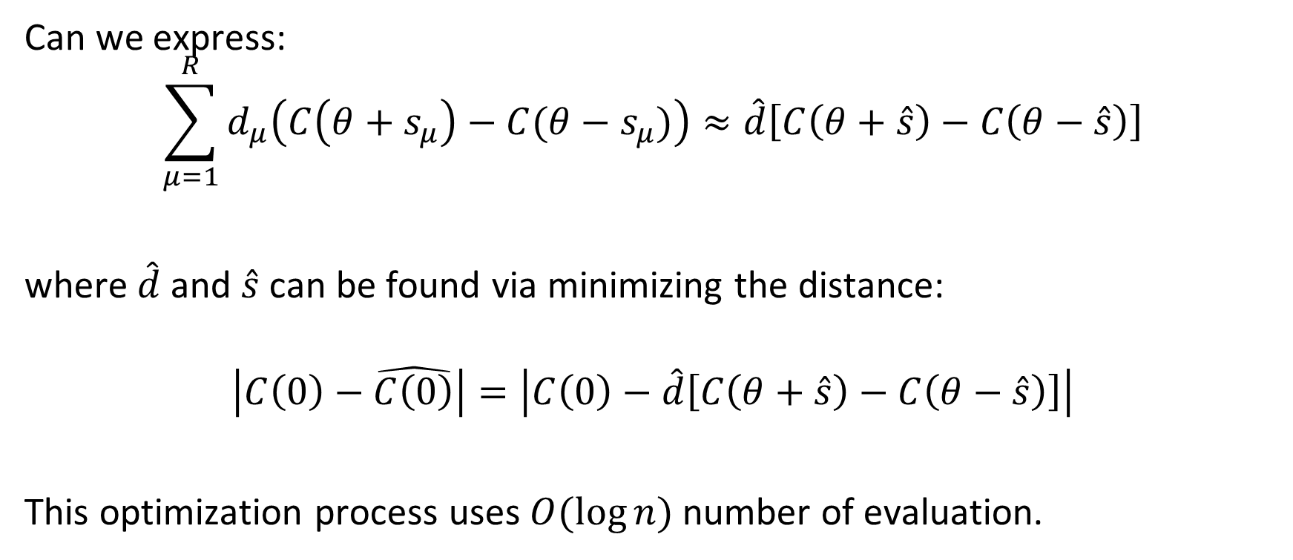
4. Pseudo parameter-shift rule
Can we express:
$$\sum_{μ=1}^{R}{d_{μ}\left(C\left(θ+s_{μ}\right)−C(θ−s_{μ})\right)}≈\hat{d}\left[C\left(θ+\hat{s}\right)−C\left(θ−\hat{s}\right)\right]$$
where $\hat{d}$and $\hat{s}$ can be found via minimizing the distance:
$$\left|C\left(0\right)−\hat{C\left(0\right)}\right|=\left|C\left(0\right)−\hat{d}\left[C\left(θ+\hat{s}\right)−C\left(θ−\hat{s}\right)\right]\right|$$
This optimization process uses $O(\log{n})$ number of evaluation.

Slide 17
4. Pseudo parameter-shift rule

Slide 18
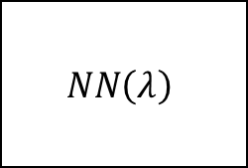

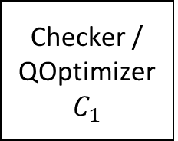
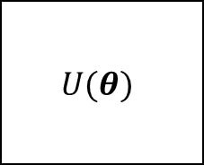



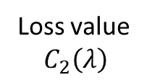
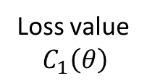
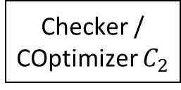
Exit classical part
Quantum embedding
$$U(θ)$$
Checker / COptimizer $C_{2}$
Input $x$
State $|\hat{x}⟩$
Update $θ$
Loss value
$$C_{1}\left(θ\right)$$
Update $λ$
Loss value
$$C_{2}\left(λ\right)$$
Checker / QOptimizer $C_{1}$
$$NN\left(λ\right)$$
Exit quantum part
End

